Slide 1
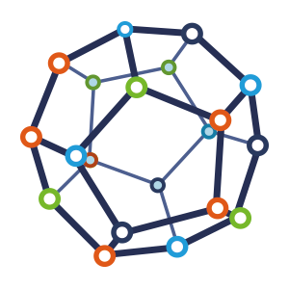


Computer Network
Class VI
lab 2

Slide 2
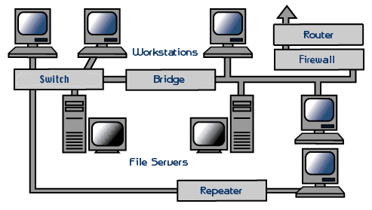
Networking Hardware
- Network Cables
- Distributors
- Routers
- Internal Network Cards
- External Network Cards

Slide 3
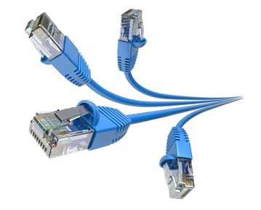
Cables
Network cables are used to connect computers. The most commonly used cable is Category 5 cable RJ-45.

Slide 4
Distributors
Network cables are used to connect computers. The most commonly used cable is Category 5 cable RJ-45.

Slide 5
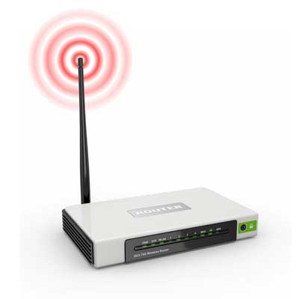
Router
A router is a type of device which acts as the central point among computers and other devices that are a part of the network.

Slide 6
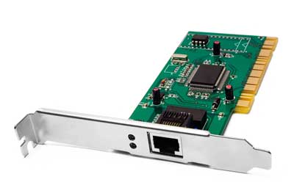
Internal Network Cards
Motherboard has a slot for internal network card where it is to be inserted

Slide 7
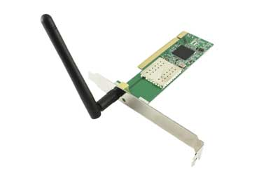
External Network Cards
External network cards are of two types:
Wireless and
USB based

Slide 8
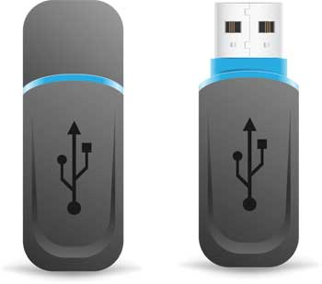
Universal Serial Bus
USB card is easy to use and connects via USB port. Computers automatically detect USB card and can install the drivers required to support the USB network card automatically.

Slide 9



